Slide 1



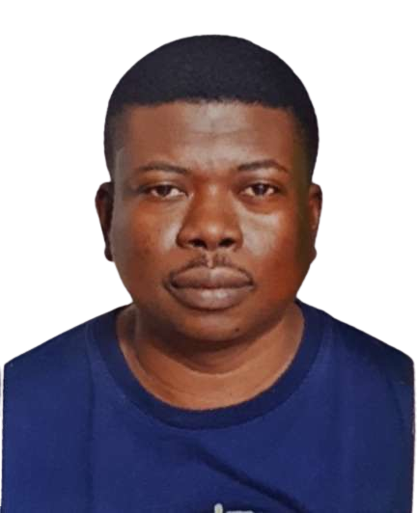



IntelliSense
Optimal Environmental Quality
Kuiyu Ding
Shola Olayemi
Sudharshan A V
Bello Nuhu
Fahadh Mohamed

Slide 2

Project Objective
To detect environmental indices by collecting relevant parameters such as;
Environmental sound quality
Temperature and Humidity
PM2.5 index.
Set different thresholds to determine how good the environmental indices are represented.

Slide 3

Project Implementation
Based on the project design, the electronics of the project were assembled and integrated around the microcontroller.
These included the following;
Tiva microcontroller - EK-TM4C123GXL
Temperature and Humidity Sensor
PM2.5 Sensor
Ultrasonic Sensor
Energia IDE was used to program the microcontroller and in C language. It was also used to display the environmental parameters obtained by the sensors.

Slide 4
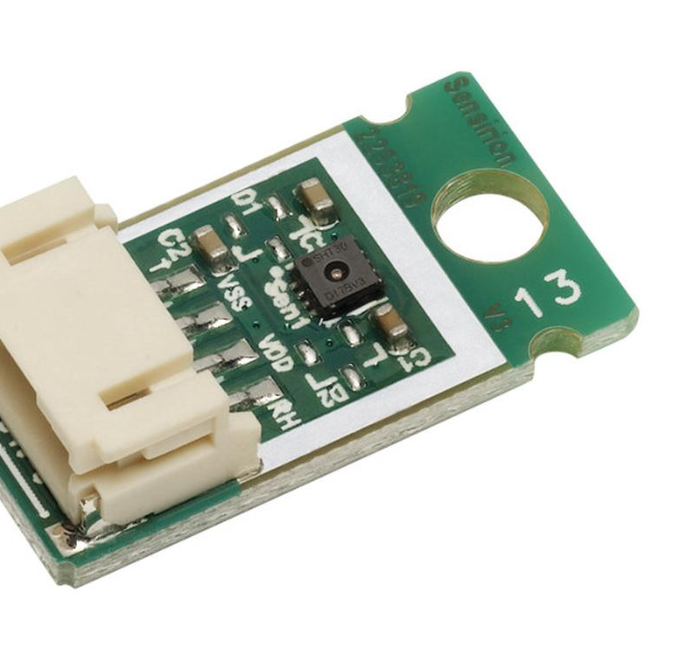
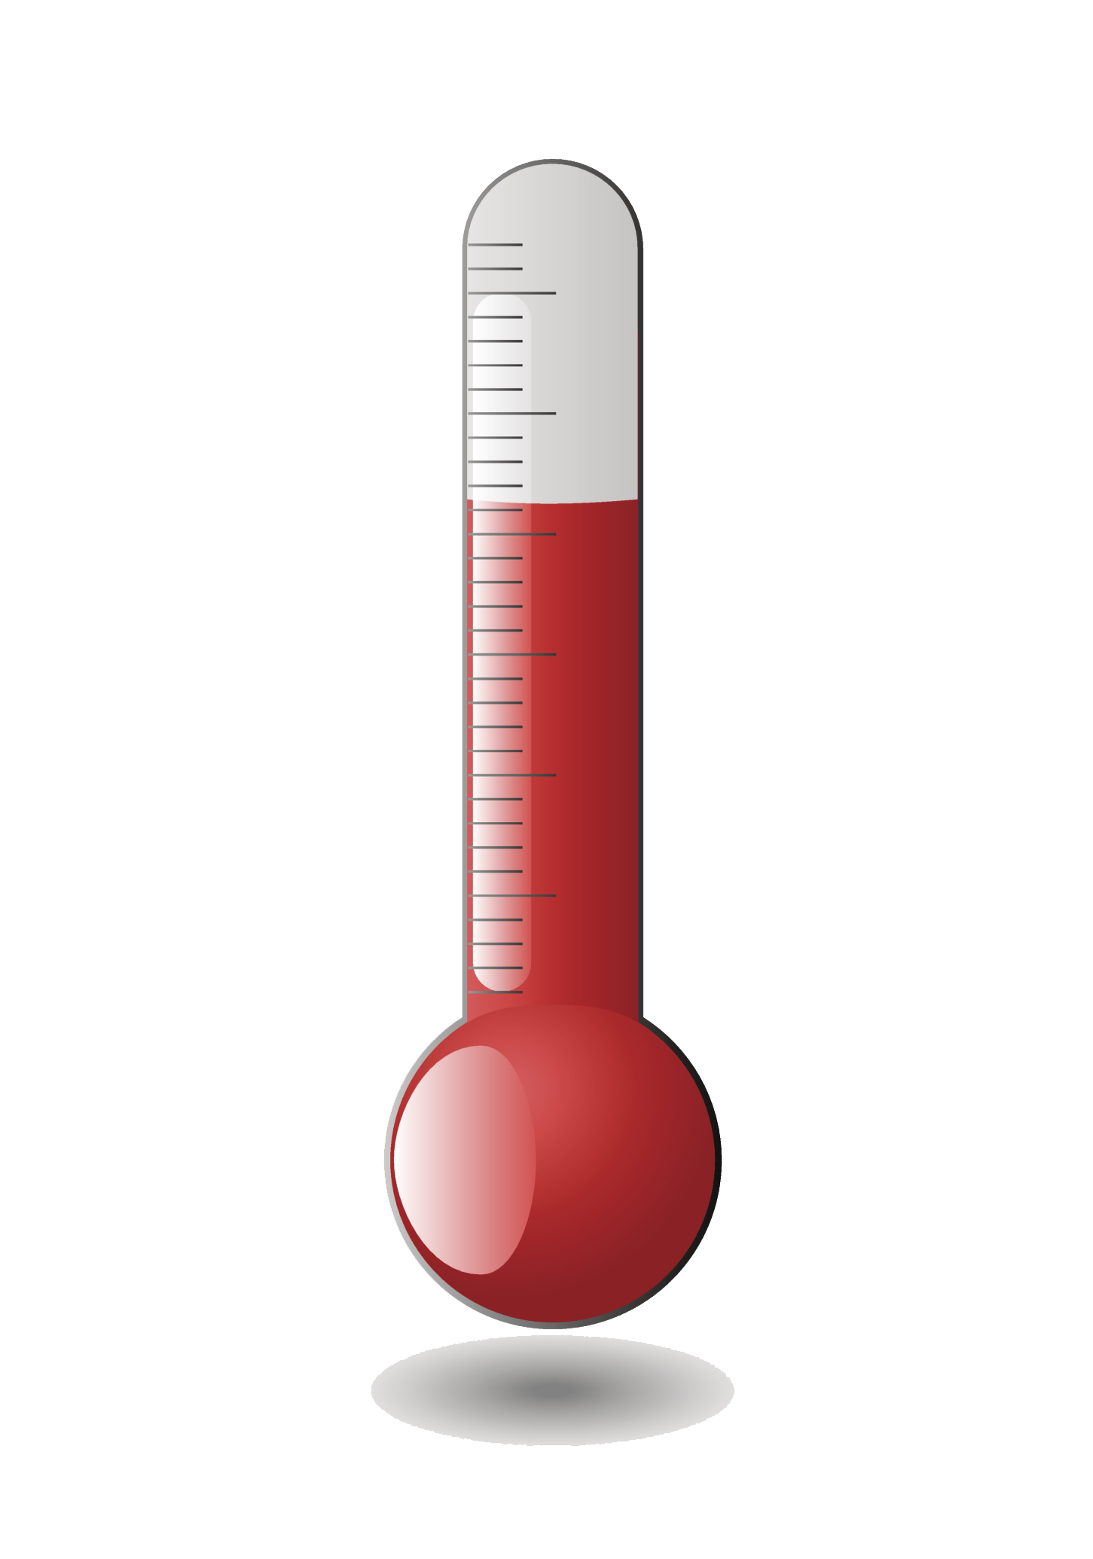
Sensors Integrated
•Temperature and Humidity Sensor
•PM2.5 Sensor
•Ultrasonic Sensor

Slide 5
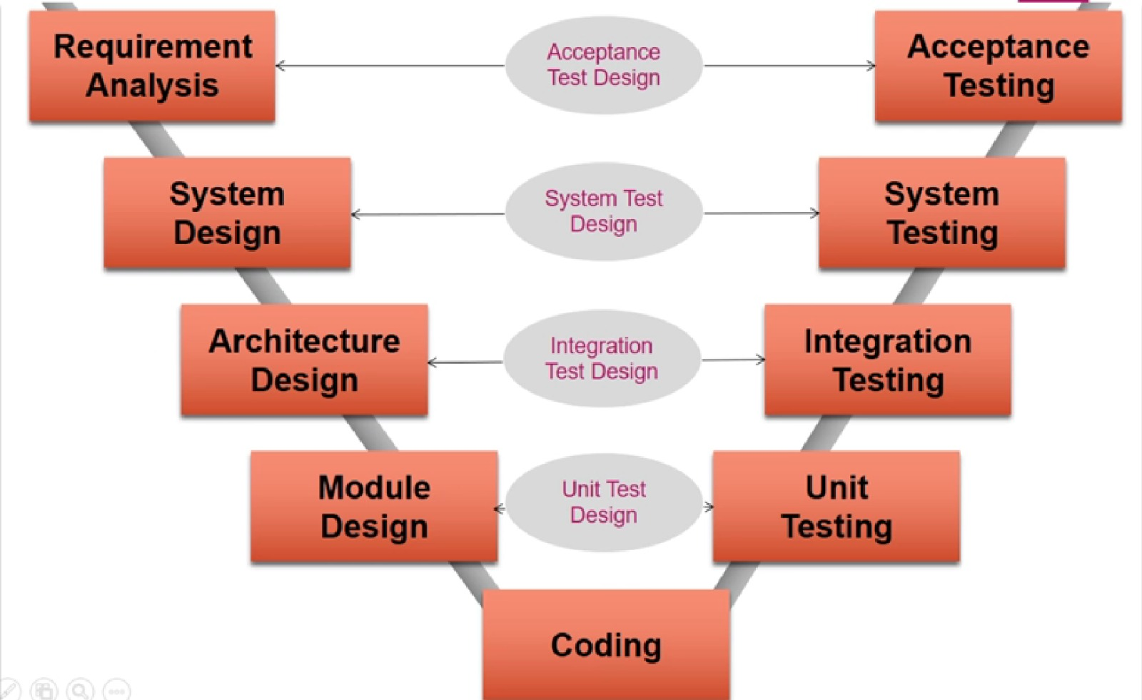
V CYCLE
The V-Cycle methodology was used to implement the project.

Slide 6
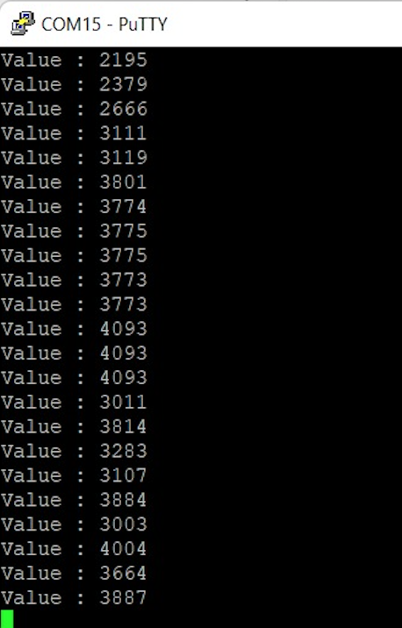
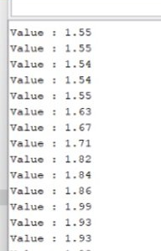
ADC and Voltage Values
via Putty
Microcontroller has a 12 bits ADC = 2¹² = 4096
VCC * ADC/4096

Slide 7
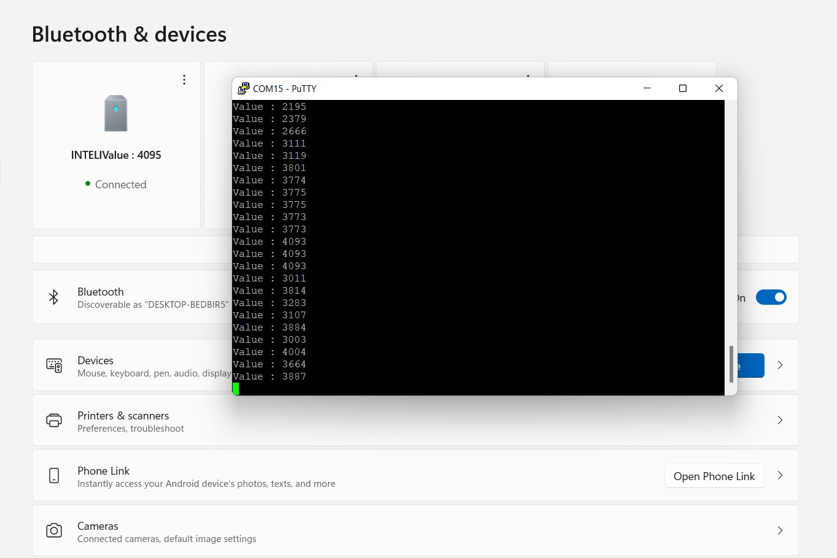
Display on PC via Bluetooth Connection

Slide 8
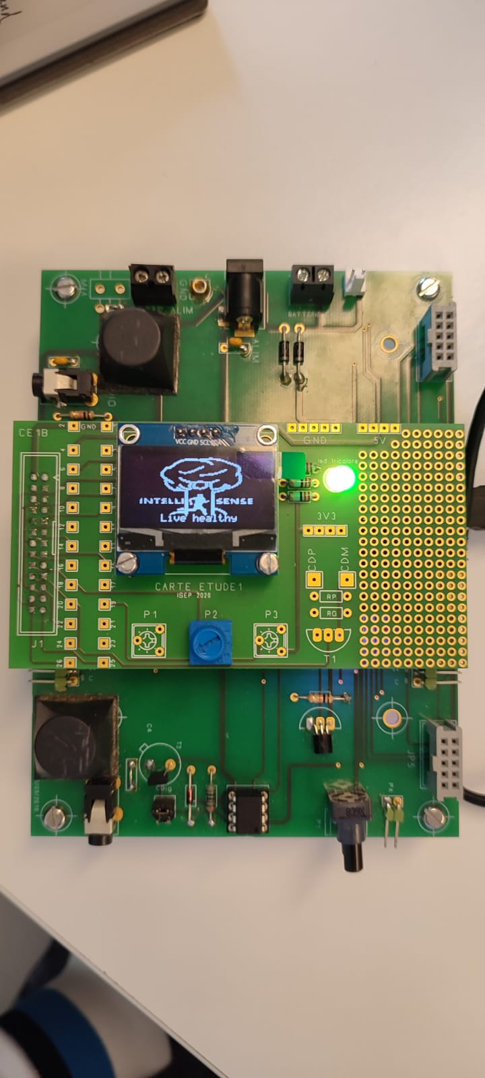
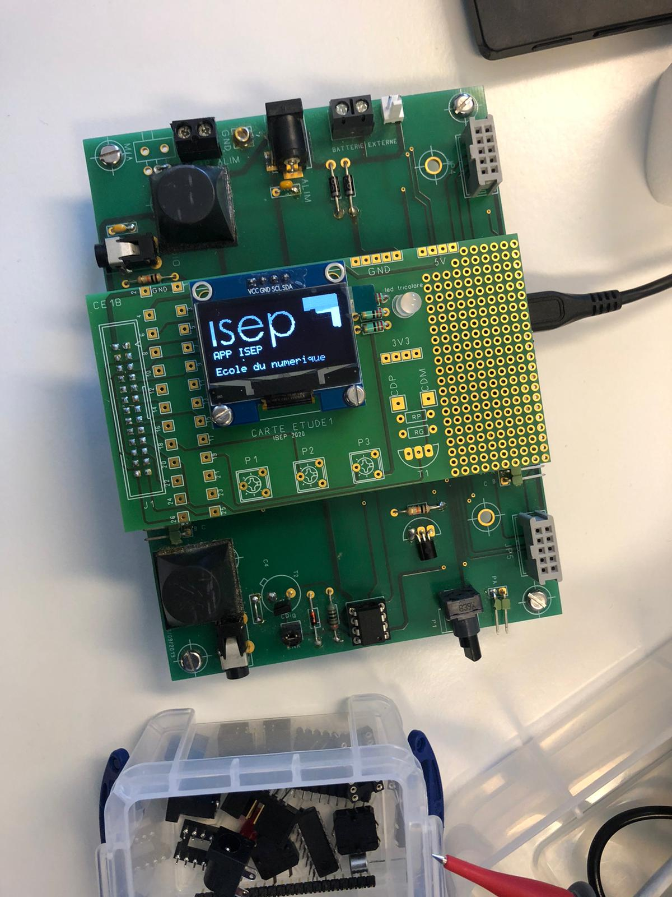
OLED DISPLAY

Slide 9
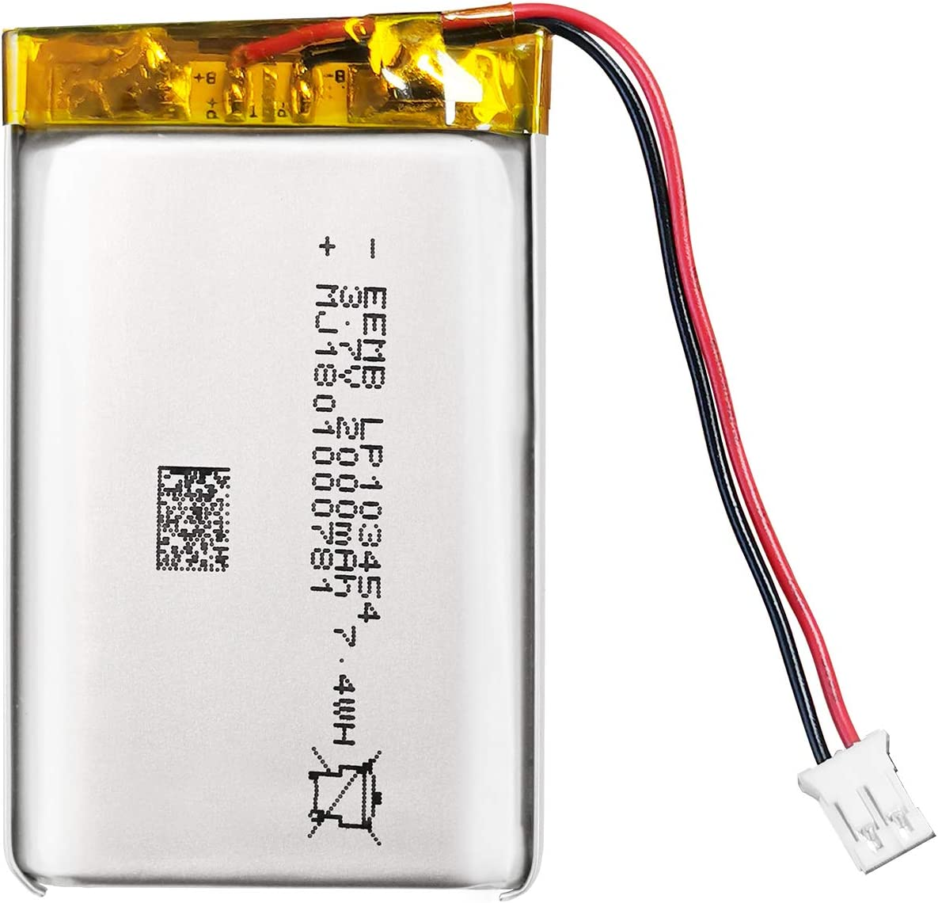
Power Consumption & Battery Autonomy
Battery Lithium-ION
EEMB 3.7V 2000mAh
103454
Battery Lithium-ION
Rechargeable with connector
Storage & Application
No leaks, excellent economic performance and long service life.
PCM protection function:
over charge, over discharge, over current, short circuit protection,
over temperature protection.
Keep cells in 40-60% state of charge during long-term storage.
Recommend charging the battery every 3 months
after receiving the battery and keeping the voltage 3.7-4.0V.
Notes:
No leaks, excellent economic performance and long service life. PCM protection function: over charge, over discharge, over current, short circuit protection, over temperature protection.
Keep cells in 40-60% state of charge during long-term storage. We recommend charging the battery every 3 months after receiving the battery and keeping the voltage 3.7-4.0V. Store the battery in a cool, dry place. // SUITABLE for Bluetooth speaker, dash cam, Wi-Fi enabled smart home systems, PDAs and digital cameras, GPS, tracking devices, pulse monitors.

Slide 10
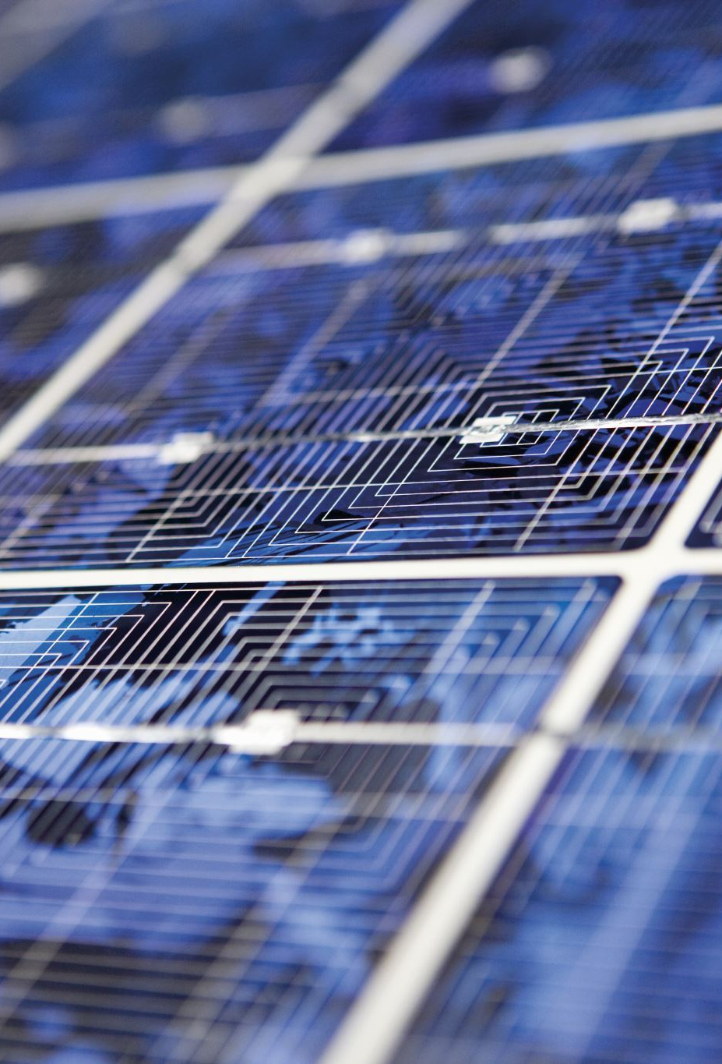
Energy Conservation
The product consumes 456mw of power
The product is expected to run for 13 hours a day.
Consequently, the power consumption is 6000mwh.
Therefore, energy consumed in 1 year = 6000 x 365 = 2,190,000mwh
i.e. 2.19Kwh
This equivalent to 0.0009 Metric Tons of CO2 = 1 pound of coal burned = 0.001 acres of US forest in 1 year.
To conserve the batter

Slide 11
Data Treatment
Fs sampling freqency imposed on microcontroller
S(t)
ADC
TRIGGER
Recording & Analysing the Signal
Key not detected recompute power for another sample
S(ms)
S(mte)
Key detected
Estimates of different measures

Slide 12
Trigger System
SilenceThreshold
Discrete Signal
Wake Device
S(mts)
Establish Silence Level
Sample Signal (Fs/4)
Power
Computation
Is power greater than the silence threshold
Key detection process
Recompute the power for another sample

Slide 13
System Operation
The device is activated by the trigger based on the power of an audio signal compared to a silence threshold.
It starts to record the data by detecting the key through the key detection process.
It measures the sound quality by computing the power of the signal and comparing it with the power of the threshold.
It measures the temperature, air quality (PM 2.5) and humidity.

Slide 14

Transmission and Display of Data
The details of the quality of the sound, temperature and PM2.5 are analyzed based on ideal conditions to advise users to go running or not.
The values and decisions would be transmitted to a cell phone via Bluetooth.

Slide 15

Future Planning
Collaborate or sell the product to a fitness app development company
Adaptation of the product to various environments.

